Slide 1
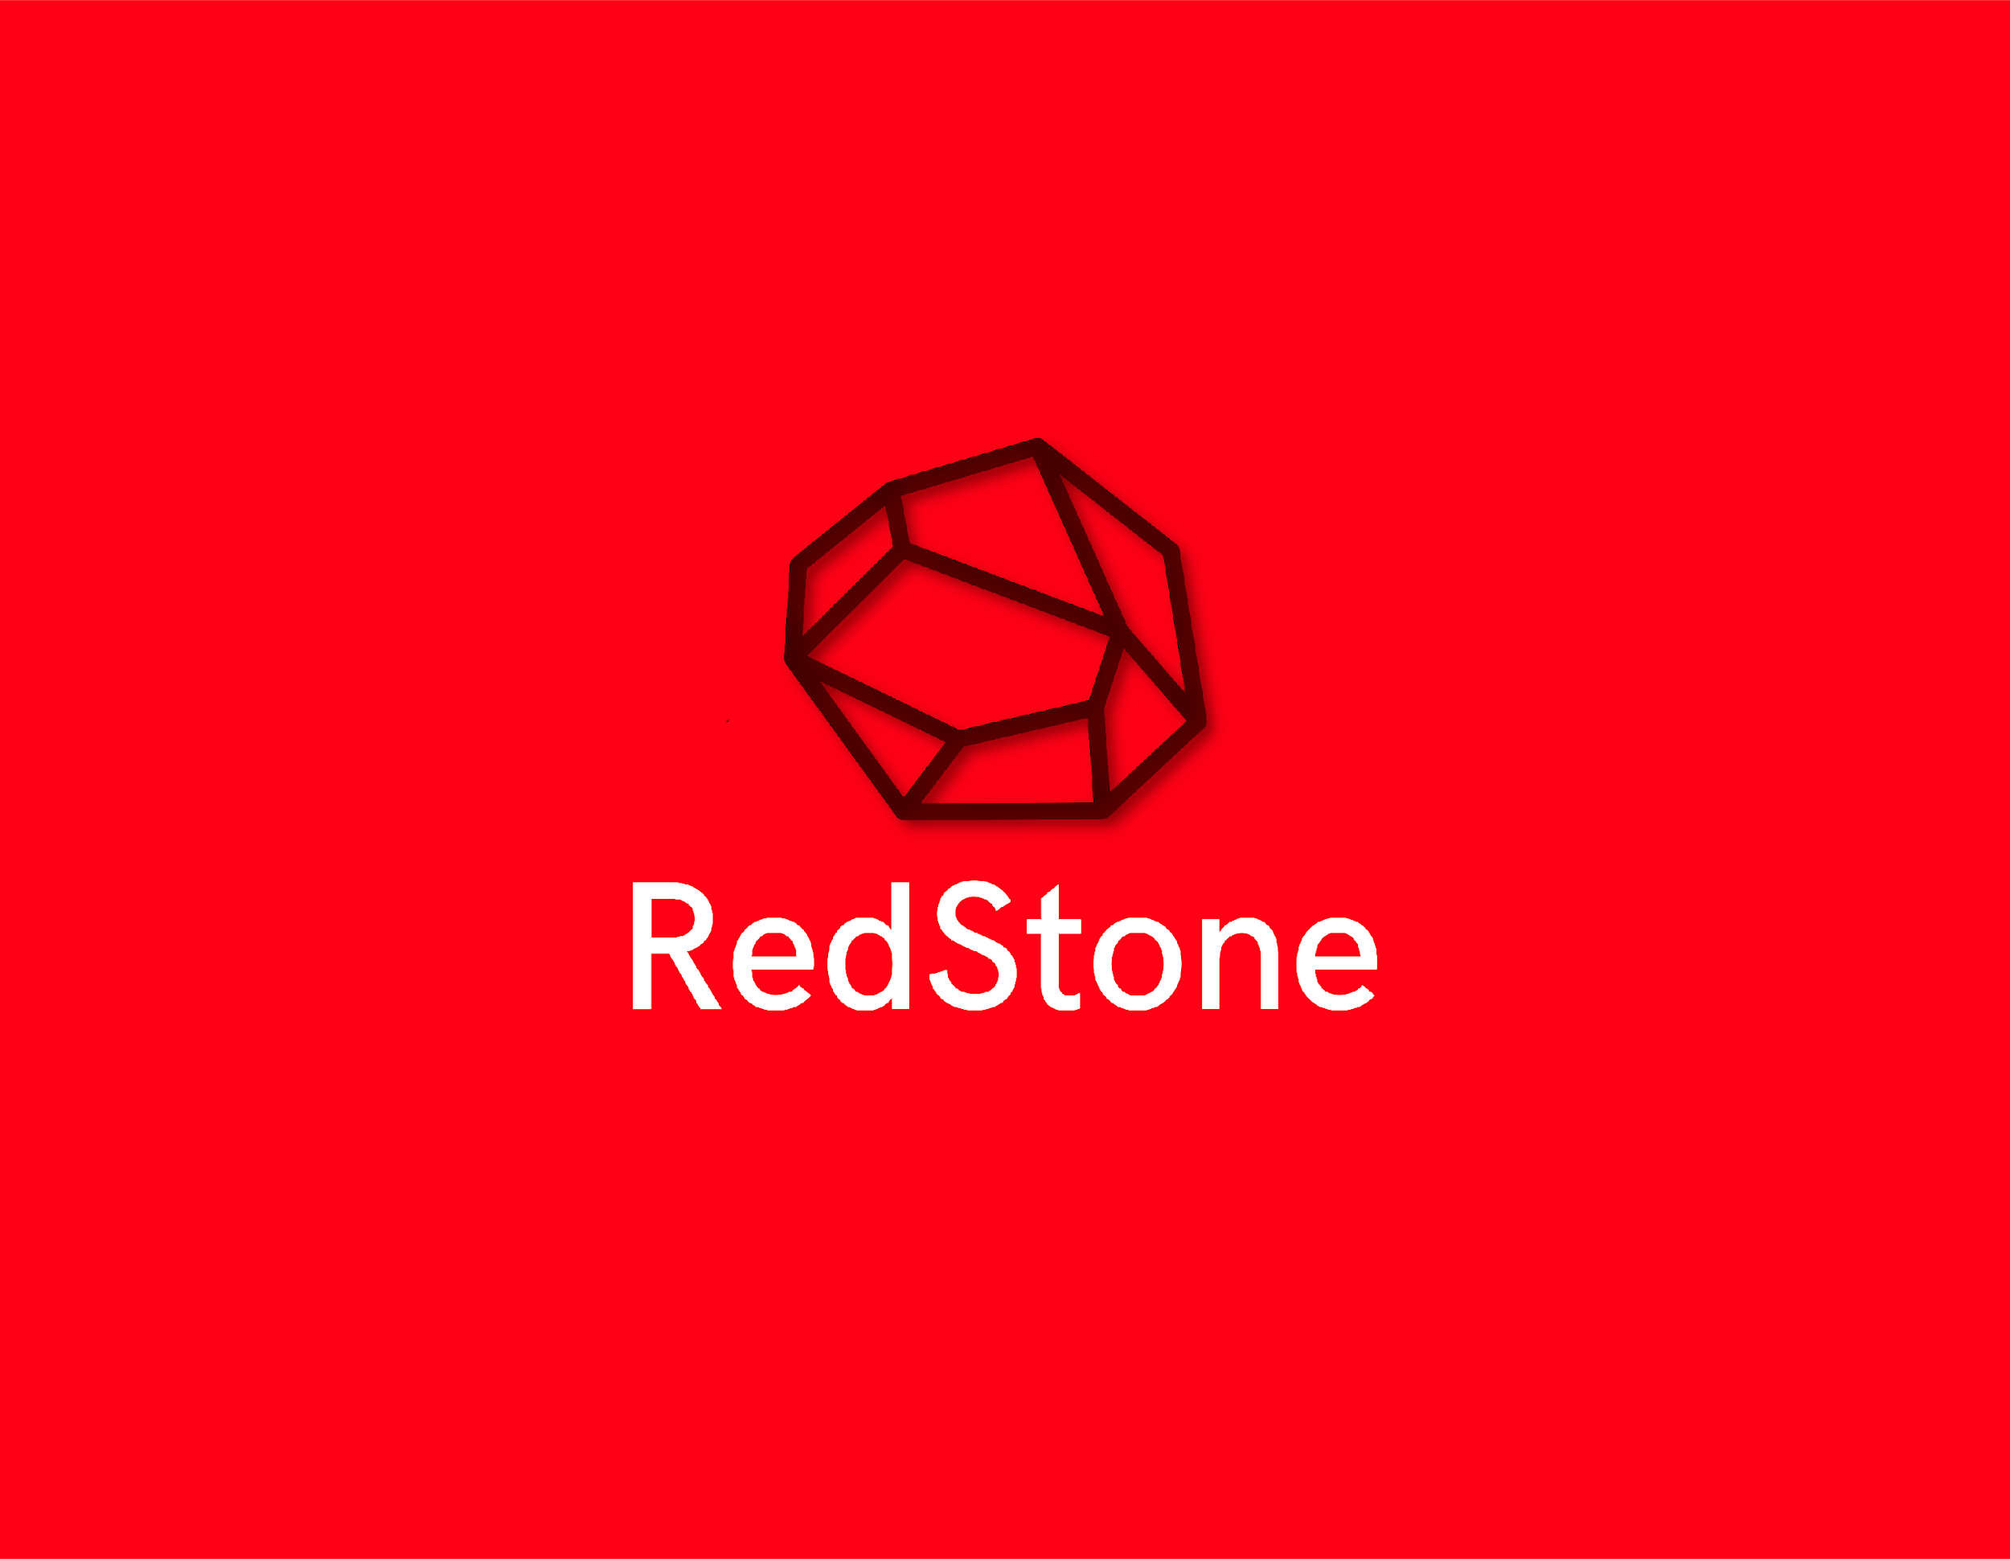
Overview & White Paper

Slide 2

The purpose of this document is to explain:
What RedStone is
Who is the team behind the technology
Why it is attractive to its customers
Details of current RedStone technology
Our vision for the future of RedStone
Details of the crowdfund token sale and how to get it
Looking for technical details?
This document is the Redstone token overview and whitepaper. If you are looking for the technical white paper instead, please download it from http://red-stone.me/technical-white-paper.pdf

Slide 3
Table of Contents
3 Introduction
4 Summary
Summary
Development
The history of RedStone
What is RedStone?
Conclusion
8 Airdrop Service Overview
9 Why should someone invest in RedStone?
10 RedStone long-term goals?
11 The RedStone token sale
12 Explanation of Airdrops

Slide 4


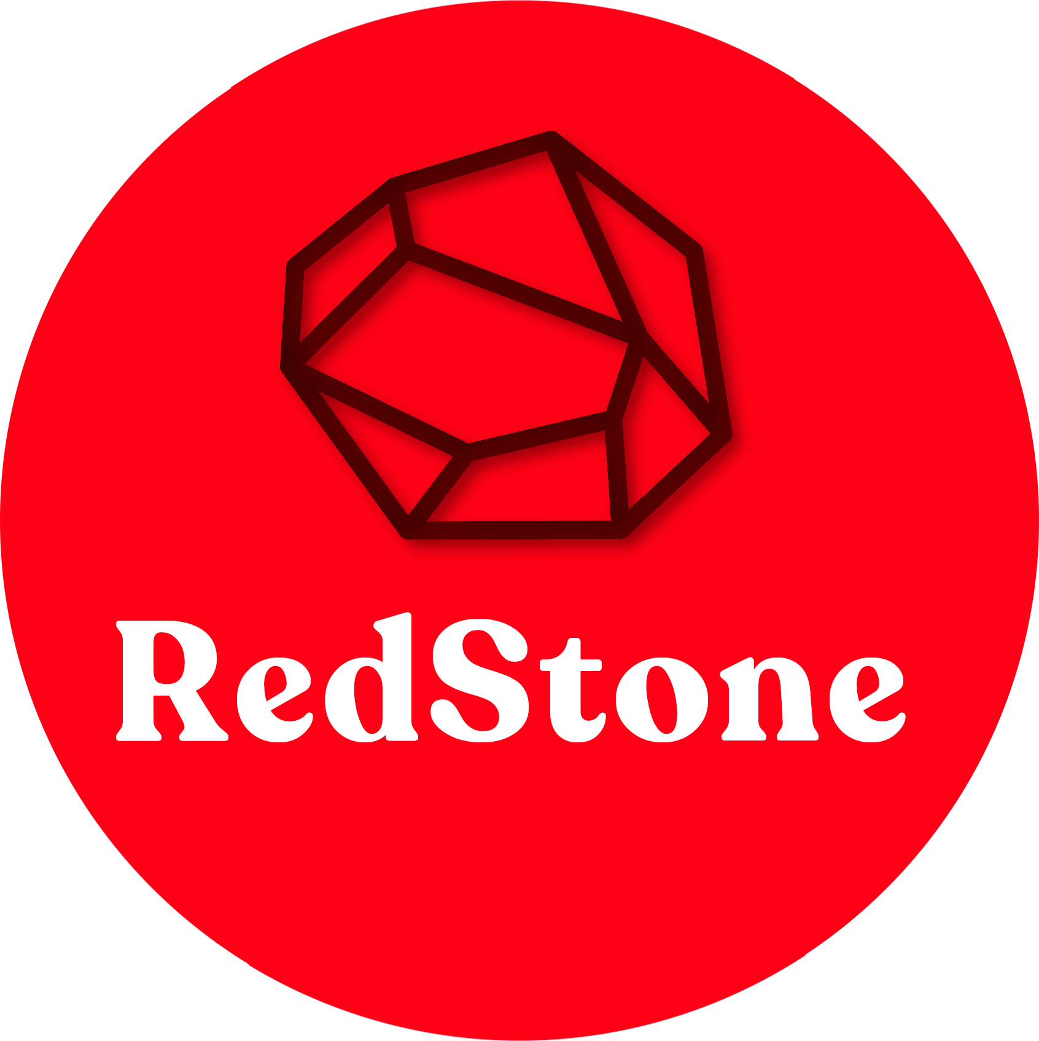

RedStone is anonymous coin that is build on the Avrio Network blockchain.
Idea of RedStone:
RedStone is anonymous coin that we are working on to improve
anonymous on internet.
RedStone is a coin that have 50 million max supply, 2.5 coins per block every block each hour of mining
▸Introduction
Summary
Airdrop Service Overview
Why should someone invest in RedStone?
RedStone on Exchanges
Explanation of Airdrop (Token)

Slide 5
This Coin is made by RedStone Devs there are Toni.Dev and Leo Cornelius
RedStone Manager is The Don
RedStone Discord OWNERS:Schweins,Rioda, and Dajo1911
RedStone Discord ADMINS:PUIP and Set Animals
RedStone Discord DEVELOPERS:Toni.Dev and Leo Cornelius
This coin you can mine on mobile phone and windows and Linux
Introduction
▸Summary
Airdrop Service Overview
Why should someone invest in RedStone?
RedStone on Exchanges
Explanation of Airdrop (Token)

Slide 6
For beginning for AirDrop Service we will give away some
RedStone TOKENS not coins they are different token are made
on ETH network coin is made on Aviro Network
Introduction
Summary
▸Airdrop Service Overview
Why should someone invest in RedStone?
RedStone on Exchanges
Explanation of Airdrop (Token)

Slide 7
You should invest in RedStone because it’s anonymous coin.
No tracking.
Idea of RedStone is anonymous Coin that can no one track and
we are want to do that if you invest in RedStone you are doing
right thing.
Introduction
Summary
Airdrop Service Overview
▸Why should someone invest in RedStone?
RedStone on Exchanges
Explanation of Airdrop (Token)

Slide 8
We want RedStone on:
Qtrade
Binance
Coinbase
Introduction
Summary
Airdrop Service Overview
Why should someone invest in RedStone?
▸RedStone on Exchanges
Explanation of Airdrop (Token)

Slide 9
RedStone TOKENS are tokens made on ERC20 code that is free
to use that coin is on ETH Test Network that will be on AirDrop
Be ready ;)
Introduction
Summary
Airdrop Service Overview
Why should someone invest in RedStone?
RedStone on Exchanges
▸Explanation of Airdrop (Token)

Slide 10
RedStone Long Term Goals
Main anonymous network.
Easier to use and buy anonymously on on internet.
More Devs.
Fix sharding.
For now :)

Slide 11


